Slide 1
Narrative Nonfiction Book Talk

Slide 2
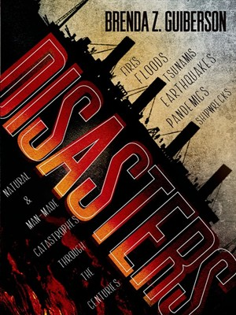
Disasters by Brenda Z. Guiberson
From the smallpox epidemic to the devastation of Hurricane Katrina, this book looks at the impact of natural occurrences and disasters on humankind.

Slide 3
Terrible Typhoid Mary by Susan Campbell Bartoletti
One cook, one terrible disease, one unbelievable story! Mary was never ill, but that didn’t keep authorities from putting her under house- arrest to get control of a disease. Because of limited medical knowledge, we see how fear can cause people to make decisions that seem so unfair! Or are they?

Slide 4
“This is the story of the plotting, the risk-taking, the deceit, and genius that created the world's most formidable weapon. This is the story of the atomic bomb” (Amazon.com Review).
The development of a devastating weapon from unassuming people.

Slide 5
Get Real by Mara Rockliff
“This frank, teen-friendly manifesto reveals what you're really buying when you spend your money on a burger, a cheap t-shirt, or a cell phone--and points the way to better choices, both for people and the planet. Start seeing the world for real, and discover how you can make a difference. You've got buying power--now let's see you change the world for good!” (mararockliff.com)

Slide 6
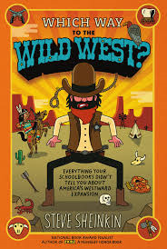
Which way to the Wild West?
By Steve Sheinkin
Everything your schoolbooks didn’t tell you about America’s westward expansion!!!!

Slide 7
Eyes wide open
By Paul Fleischman
“Take 250 years of human ingenuity. Add abundant fossil fuels. The result: a population and lifestyle never seen before…”

Slide 8
Fooled You!
Fairies caught on film
Crop Circles
HOAXES
Aliens on Earth
Giant cats!!!

Slide 9
The Warrior’s Heart by Eirc Greitens
“As a humanitarian, he helped aid workers heal orphaned children in Rwanda and lived in camps alongside Bosnian refugees. As a warrior, he excelled at the hardest military training in the world and teamed up with fellow SEALs to hunt al Qaeda terrorists in Iraq.”

Slide 10
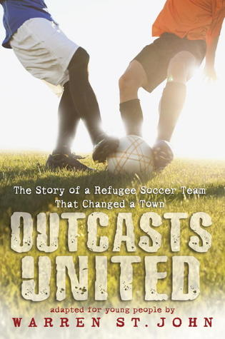
Outcasts United by Warren St. John
“Outcasts United is the story of a refugee soccer team, a remarkable coach and a small southern town turned upside down by the process of refugee resettlement” (outcastsunited.com).

Slide 11
Unlikely Warrior by Georg Rauch
Georg Rauch helped his mother hide dozens of Jews from the Gestapo behind false walls in their top-floor apartment and arrange for their safe transport out of the country. Then came the day he was drafted into Hitler's army and shipped out to fight on the Eastern front as part of the German infantry―in spite of his having confessed his own Jewish ancestry. Unlikely Warrior is Rauch's true account of this extraordinary adventure.

